Slide 1
DOC*X – a research resource on occupational health
Arbejds- og Miljømedicinsk Afdeling
A nationwide occupational cohort with job and exposure data

Slide 2
DOC*X – Setting and Aim
Arbejds- og Miljømedicinsk Afdeling
Setting: To extend the possibilities for register based research in occupational medicine
  Danish registers (in particular linkage at individual level) are unique sources of information in epidemiological research (among others)
  In research in occupational medicine nationwide registers lack exposure descriptions
  Job exposure matrices (JEM) may fill in this gap
Aim: A nationwide register based occupational cohort with job exposure matrices

Slide 3
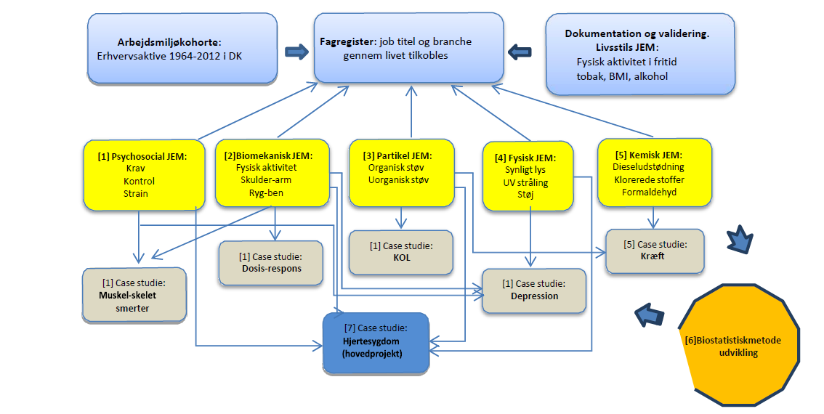
DOC*X – Project overview
Arbejds- og Miljømedicinsk Afdeling

Slide 4
DOC*X – Jobregister
Arbejds- og Miljømedicinsk Afdeling
Employed in Denmark (1970) 1976 - 2012 (and onwards)
  From 15th year to latest year with employment
  Yearly report of primary employment
    Entire year or late November
  6.2 million individuals
  2.0 to 2,7 million individuals in employment yearly
  Around 75 % have registered Job codes

Slide 5
DOC*X – Job Exposure Matrices I
Arbejds- og Miljømedicinsk Afdeling
Psychosocial factors, questionnaire data
  Psychosocial demands
  Job control
  Job strain
  Biomechanics, expert ratings, technical measurements
  Lower body JEM
  Shoulder / arm
  Energy consumption
Light, technical measurements
  Visible light
  UV-radiation
Noise, technical measurements
  Occupational noise

Slide 6
DOC*X – Job Exposure Matrices II
Arbejds- og Miljømedicinsk Afdeling
Dust
  Organic dust, technical measurements
  Wood, technical measurements
  Endotoxin, technical measurements
  Quarts, Asbestos, based on ALOHA and SYNJEM
Selected chemical agents, NOCCA-JEM
  Diesel exhausts
  Chlorinated agents
  formaldehyde,
Lifestyle, questionnaire data
  Smoking
  Alcohol consumption
  Body mass index
  Physical activity in leisure time
  Diet, fruit and vegetables

